Slide 1


Slide 2
Why WE like FreeBSD
Presented By: Yukaia & d3c4f

Slide 3
Who are we?

Slide 4
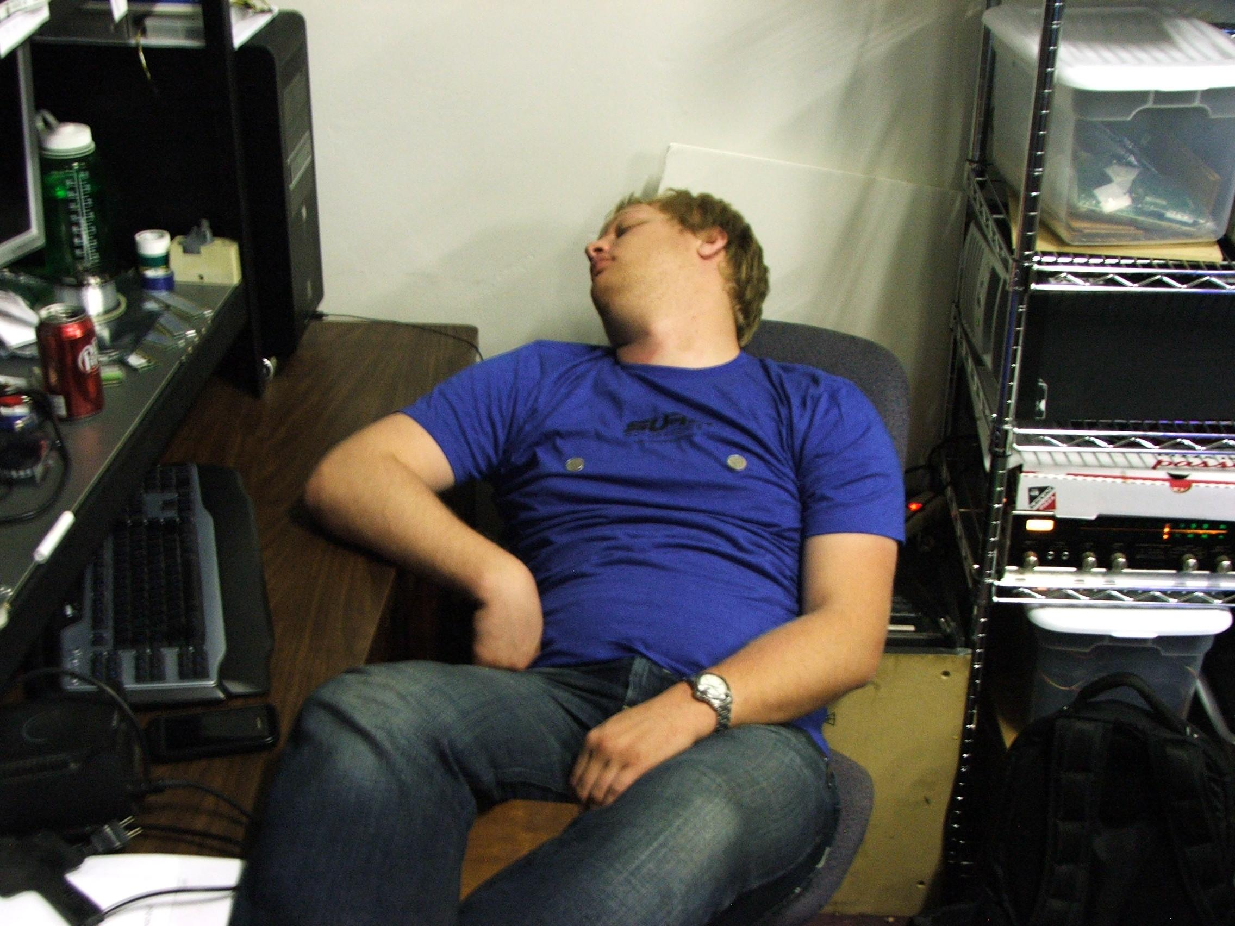
Who are we?
Yukaia

Slide 5
Who are we?
Yukaia
Systems Administrator
Automobile Enthusiast
PortAParty Co-Creator
theTransistor Founder
Blackhat Volunteer
Dr.Pepper Connoisseur

Slide 6
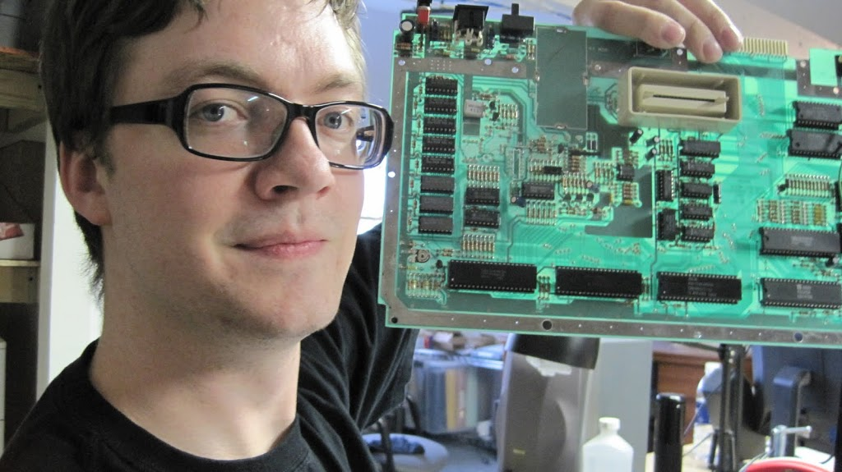
Who are we?
d3c4f

Slide 7
Who are we?
d3c4f
Software Developer
Systems, DB, Net Administrator
PortAParty Co-Creator
theTransistor Founder
Caffeine Addict
OpenWest Core Team
BlackHat Volunteer
Electronic Badge Designer

Slide 8
So what DO we like about FreeBSD?

Slide 9
So what DO we like about FreeBSD?
Consistency & Stability
Adheres to its standards
ZFS (Zetabyte Filesystem)
Fast & Lightweight
Ports / Portmaster
Jails / BHYVE
PF
The FreeBSD Handbook

Slide 10
What do WE use FreeBSD for?
Things we actually are using it for, or have used FreeBSD for in the past.

Slide 11
What do WE use FreeBSD for?
PortAParty
GameCache, File Shares, Web Servers, (future) Game Servers, ELK / Data, Firewall, SNORT IDS/IPS, Network QOS, Routing
Home
OpenVPN, NAS, Web Servers, GIT Server, Seedboxes, Disaster Recovery, Firewall, IDS/IPS, QOS, Routing
Work / Fun
Web Servers, IRC Bouncers, Disaster Recovery, OpenVPN, Asterisk, Data Collection and Analysis, Firewalls, IDS / IPS, QOS, Routing, etc

Slide 12
The History of FreeBSD

Slide 13
The History of FreeBSD
1969
UNIX is created at Bell Labs. This was mostly written in PDP-7 assembly.

Slide 14
The History of FreeBSD
1973
UNIX is rewritten in C.

Slide 15
The History of FreeBSD
1974
UNIX is licensed to universities. For educational purposes, it is distributed with source code.

Slide 16
The History of FreeBSD
1974-1980
Berkley releases free patches for all of it’s work on UNIX, so long as you have a license for UNIX.

Slide 17
The History of FreeBSD
1980
4BSD (Berkeley Software Distribution) is released by Berkeley as a complete system. It comes with Curses, Job Control in CSH, and more. At this point, it still does not have networking support.

Slide 18
The History of FreeBSD
1984
4.2BSD is released. This includes; Fast File System (or UFS), a modified version of BBNs TCP/IP implementation, and a handful of other changes. This is also the first version that Beastie the BSD Daemon appears (USENIX). DARPA begins funding the BSD project.

Slide 19
The History of FreeBSD
1986
4.3BSD is released. Machine dependent code is broken out to help make BSD more portable. BSD creates its own TCP/IP implementation, but DARPA pushes for BBNs TCP/IP implementation and that is included instead.

Slide 20
The History of FreeBSD
1989
Network Release 1, a separate release of just the networking code from 4.3BSD, is made freely available under the BSD license. This contained no AT&T code, which would have required users to pay for it. This is one of
the first projects under BSD license.

Slide 21
The History of FreeBSD
1991
Net/2 is released. This is almost a complete OS. It is a rewrite of all the AT&T utilities in BSD. There are only a few AT&T files remaining in the Kernel, these are removed for the release of Net/2.

Slide 22
The History of FreeBSD
1991 (Later)
Net/2 becomes the base for two x86 ports: the open-source 386BSD, and closed-source BSD/386 (later BSD/OS) from BSDi. 386BSD doesn’t last very long, but becomes the foundation for NetBSD and FreeBSD.

Slide 23
The History of FreeBSD
1992
AT&T/USL sues BSDi and Berkeley over licensing concerns. An injunction on the distribution of Net/2 was issued for the duration of the lawsuit.
Note:
Linus Torvalds has said that if 386BSD had been available at the
time, he probably would not have created Linux.

Slide 24
The History of FreeBSD
1993
FreeBSD 1.0 is released.

Slide 25
The History of FreeBSD
1994, January
4.4BSD is released. The AT&T/USL lawsuit against BSDi and Berkeley is settled, Berkeley wins! 3 Files have to be removed and 70 have to be updated to show AT&T/USL copyright notices (out of 18,000 files).

Slide 26
The History of FreeBSD
1994, June
4.4BSD-Lite and 4.4BSD-Encumbered are released. 4.4BSD-Lite contains no AT&T code.

Slide 27
The History of FreeBSD
1994, November
FreeBSD 2.0 is released. The original 386BSD code is replaced with 4.4BSD-Lite code.

Slide 28
Other BSD Versions and Projects

Slide 29

Other BSD Versions and Projects
HardenedBSD (shout-out to lattera)
OpenBSD
NetBSD
PFSense / OPNSense
(built on FreeBSD, for now)
DragonflyBSD
OpenDarwin
PC-BSD

Slide 30
Other BSD Versions and Projects
HardenedBSD
A security-hardened edition of FreeBSD
Features:
ASLR ( Address-Space Layout Randomization )
SECADM ( Security Admin )
IntegriForce: Kernel-Based File Integrity System
ASLR can be enabled on a per jail/binary.
Segvgaurd
and many more security features

Slide 31
Other BSD Versions and Projects
OpenBSD
Created by Theo de Raadt (a NetBSD Founder)
Fork of NetBSD 1.0
OpenSSH, OpenNTPD, PF, LibreSSL, OpenBGPD, and more are project that all originate from OpenBSD.

Slide 32
Other BSD Versions and Projects
DragonflyBSD
Fork of FreeBSD 4.8 by Matthew Dillon
Largely considered a research OS
Is now very different from FreeBSD on a technical level

Slide 33
Other BSD Versions and Projects
PC-BSD
The most popular graphical BSD desktop environment
Based on FreeBSD (not a fork)
Provides a graphical installer
Creators of Lumina desktop environment, which is written for FreeBSD

Slide 34
FreeBSD / *BSD Stats & Who uses *BSD?

Slide 35
FreeBSD / *BSD Stats & Who uses *BSD?
NetFlix
About 36.5% of ALL *peak* internet traffic in North America!
NOTE: It’s been estimated that about ½ of all North American internet traffic is running on FreeBSD.

Slide 36
FreeBSD / *BSD Stats & Who uses *BSD?
Juniper, Cisco, Brocade, etc
Cisco: IronPort and their malware sandbox infrastructure as ran by their Talos Security Research Group
Many major products built on FreeBSD
Other Gateways, Firewalls, Routers, etc

Slide 37
FreeBSD / *BSD Stats & Who uses *BSD?
Mach Kernal (OSX)
OSX is based on NeXTSTEP which is based on the Mach Kernel and contains portions of BSD
The kernel that Apple uses/maintains is the XNU Kernel XNU stands for X is Not Unix, it’s opensource and is used in iOS, OSX and Darwin.

Slide 38
FreeBSD / *BSD Stats & Who uses *BSD?
Sony’s Orbis OS (PS4)

Slide 39
FreeBSD / *BSD Stats & Who uses *BSD?
The FreeBSD TCP/IP stack is considered the reference.

Slide 40
Break out the safeword. Time to talk BSD

Slide 41
Break out the safeword. Time to talk BSD
We’re going to cover, a little more in-depth:
FreeBSD -vs- Linux
Similarities
Differences
Features WE like
ZFS, Jails, BHYVE, Consistency of file locations, Speed / Security, PortMaster, ZSH/OMZSH

Slide 42
FreeBSD -vs- Linux: Similarities

Slide 43
FreeBSD -vs- Linux: Similarities
Installation / CLI is very much the same
Both are heavily based around the CLI
Most file locations are the same
Many of the same packages
FREE (as in source)
Both intend to be POSIX compliant
Heavily technical user base
Enterprise support is available for both

Slide 44
FreeBSD -vs- Linux: Differences

Slide 45
FreeBSD -vs- Linux: Differences
FreeBSD is developed as an entire OS
All other BSD systems are the same
BSD OSes are developed independently of each other (including the Kernel). They often share patches and applications.
Linux is just a Kernel

Slide 46
FreeBSD -vs- Linux: Differences
File locations are actually consistent
Many Linux distros like to a ignore /usr/local/ or even worse, ignore it just most of the time.
FreeBSD keeps software that is not part of the base OS install pretty much limited to /usr/local/
ex. /usr/local/etc/ for configs
ex. /usr/local/bin/ for binaries
ex. /usr/local/sbin/ for system daemons
...and so on. (It’s Consistent)

Slide 47
FreeBSD -vs- Linux: Differences
FreeBSD is a democracy. LINUX is a dicktatorship dictatorship.
FreeBSD changes are guided a core-team
Responsible for deciding overall goals and managing areas of development
If you have a “Commit Bit” you can vote in core-team elections.
Linux changes are controlled by Linus Torvalds

Slide 48
FreeBSD -vs- Linux: Differences
FreeBSD comes directly from UNIX
Forked from BSD, which was started by a group at Berkeley as a research project by Bill Joy to extend UNIX functionality
Linux was developed from the ground up
Started by Linus Torvalds

Slide 49
FreeBSD -vs- Linux: Differences
FreeBSD is mostly POSIX compliant
Linux, while currently mostly POSIX compliant, is moving away from these standards (ex. SystemD).

Slide 50
FreeBSD -vs- Linux: Differences
FreeBSD is licensed under the BSD License
VERY permissive license. Not copy-left
Focus is on the user, only need to keep headers
Simplified 2-clause license
Linux is licensed under GPLv2
Code is guaranteed freedom. Not the user
Comparatively complex code publishing requirements

Slide 51
FreeBSD -vs- Linux: Differences
FreeBSD has a nicer (ioho) Init System
Linux SysV / Upstart were a bit of a pain. Got replaced with a whole OS. (SystemD, yuck!)

Slide 52
FreeBSD -vs- Linux: Differences
FreeBSD has better support for building packages from scratch. And promotes this method. (Still has pre-built packages)
Linux promotes installing pre-built packages instead of building. (Still has build-from-source option)

Slide 53
FreeBSD features we like

Slide 54
FreeBSD features we like
Speed / Security
FreeBSD is very organized. This helps greatly!
FreeBSD is developed around speed and stability
Includes many security features
Check out HardenedBSD!
Kernel-Level File Integrity Checks
ASLR
and tons more!
https://www.freebsd.org/features.html for more information.

Slide 55
FreeBSD features we like
Ports
Found in /usr/ports/
Each individual port has its own directory
Each has its own makefile, and description file
Each includes patches it needs to build and run

Slide 56
FreeBSD features we like
Ports
There are a couple ways to install/upgrade the ports tree:
portsnap
subversion

Slide 57
FreeBSD features we like
Ports
portsnap ports tree installation
Download compressed Ports tree to /var/db/portsnap/
# portsnap fetch
Extract to /usr/ports/
# portsnap extract
Update at a later time:
# portsnap fetch update

Slide 58
FreeBSD features we like
Ports
subversion ports tree installation
a little more involved (not bad though)
used if you need more control
we aren’t going to cover this in this talk.

Slide 59
FreeBSD features we like
Building and Installing Ports

Slide 60
FreeBSD features we like
Building and Installing Ports
Ports can be built and installed using a few methods.
make
Using normal make commands to build packages
portmaster
Package management for port building

Slide 61
FreeBSD features we like
Portmaster

Slide 62
FreeBSD features we like
Portmaster
First build portmaster (after you install ports)
# cd /usr/ports/ports-mgmt/portmaster
# make install clean

Slide 63
FreeBSD features we like
Portmaster
Find a port to install
# whereis [program name]
Browse the /usr/ports/ directory
Search https://freshports.org/

Slide 64
FreeBSD features we like
Portmaster
Build and Install a port
# portmaster [category]/[port_name]
Update all outdated ports
# portmaster -a
Update all outdated, and clean distfiles
# portmaster -ad

Slide 65
FreeBSD features we like
pkg (pkgng)

Slide 66
FreeBSD features we like
pkg (pkgng)
“I don’t like building ports, it’s scary and takes a long time. Can’t I just get prebuilt binaries with default options?”
(yes, yes you can.)

Slide 67
FreeBSD features we like
pkg (pkgng)
Get information about a specific package:
# pkg info [packagename]
Install a package:
# pkg install [packagename]
Remove a package:
# pkg delete [packagename]

Slide 68
FreeBSD features we like
pkg (pkgng)
Audit installed packages
# pkg audit -F
Automatically remove leaf dependencies
# pkg autoremove
Remove stale packages:
# pkg clean

Slide 69
FreeBSD features we like
pkg (pkgng) and portmaster notes
Ports is latest stable release. pkg is usually only a few days behind. FreeBSD does weekly package builds on Wednesdays.
If using both systems, you should not upgrade packages with pkg, it can break things. Only upgrade with ports.
The best option is just to pick one or the other.

Slide 70
FreeBSD features we like
Service installation notes
To automatically start a newly installed service, you typically just edit the /etc/rc.conf file.
Make sure the following is inside that file
[service_name]_enable=”YES”
To start or stop the service manually
# service [service_name] start
# service [service_name] stop

Slide 71
FreeBSD features we like
ZFS ( ZetaByte File System )
128 Bit, B-Tree, Copy-On-Write
Every Block of Data has a checksum, stored in pointer
Built-In Volume Manager, no need for LVM
Block-level DeDup, snapshots, compression & clones
RAID 0, 1, Z, Z2, Z3, and more
Multiple Block-Caching Levels to RAM and SSD
Keeps an intent log (ZIL) for data writes
Offloaded ZILs enable asynchronous writes

Slide 72
FreeBSD features we like
BHYVE
BSD Licensed, legacy-free HyperVisor
Still fairly new
Can run FreeBSD, OpenBSD, NetBSD and Linux VMs
Windows support is in progress
Supports AMD64 and i386 architectures

Slide 73
FreeBSD features we like
Jails
OS Level Virtualization (aka containerization)
Has been in FreeBSD since version 4 (March 2000)
Creates a safe environment, away from the rest of the system.
Processes ran inside a Jail cannot access files or resources outside of the Jail.

Slide 74
FreeBSD features we like
PF ( OpenBSD Packet Filter)
Integrated as part of the base since FreeBSD 5.3
Complete, full featured firewall
Provides QOS
Utilizes ALTQ for traffic shaping
Easy to read rules

Slide 75
FreeBSD features we like
PF ( OpenBSD Packet Filter)
Enable PF by editing /etc/rc.conf, add:
pf_enable=”YES”
pf_flags=”” #additional flags for pfctl startup
pf_rules=”/etc/pf.conf” #default ruleset
If there is a LAN behind the firewall, or NAT is required
gateway_enable=”YES”
Start PF manually
# service pf start

Slide 76
FreeBSD features we like
PF ( OpenBSD Packet Filter)
Enable PF Logging by editing /etc/rc.conf, add:
pflog_enable=”YES”
pflog_logfile=”/var/log/pflog”
pflog_flags=”” #additional options
Start PF manually
# service pflog start

Slide 77
FreeBSD features we like
PF ( OpenBSD Packet Filter)
To control PF, use pfctl
Enable PF:
# pfctl -e
Disable PF:
# pfctl -d
Flush NAT, Filter, State, and Table Rules, and reload
# pfctl -F all -f /etc/pf.conf
Check configuration for error, do not load
# pfctl -vnf /etc/pf.conf

Slide 78
FreeBSD features we like
Linux Binary Compatibility
FreeBSD provides a Kernel Module that enables the use of most 32-bit Linux binaries (unmodified). In some situations Linux applications actually perform better on FreeBSD then they do on Linux.
http://www.phoronix.com/scan.php?page=article&item=linux_games_bsd
http://www.phoronix.com/vr.php?view=18989

Slide 79
FreeBSD features we like
Linux Binary Compatibility
To enable 32-bit Linux Binary Support run:
# kldload linux
Verify that the Kernel Module has been loaded:
# kldstat
To enable at runtime, edit /etc/rc.conf
linux_enable=”YES”

Slide 80
Literature & References
The FreeBSD Handbook
Some of the best project documentation
https://www.freebsd.org/doc/handbook/
Books
http://www.nostarch.com/abs_bsd2.htm
Links
https://www.over-yonder.net/~fullermd/rants/bsd4linux/01
https://youtu.be/5mv_oKFzACM
http://www.bsdnow.tv
http://bsdmag.org

Slide 81
Demo Time (time-permitting)
Installation
Get and extract the ports database
Build and install portmaster
Use portmaster to build and install vim-lite
Show /etc/rc.d
Start/Stop Service(s)
Show directory structure
???

Slide 82
Q & A
(Ask now)

Slide 83
That’s all, Folks!
We hope you enjoyed this presentation. Now get out there and install some FreeBSD / *BSD systems!

